Slide 1
European and national
research infrastructures landscape:
France
05/06/2024
Conference: Research Infrastructures in a changing global,
environmental and socio-economical context
Dr. Elena HofferT
ESFRI delegate for France

Slide 2
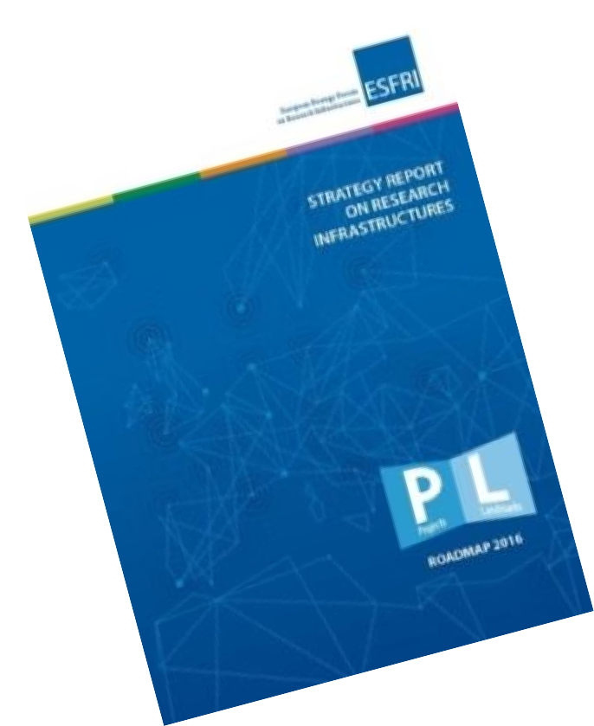
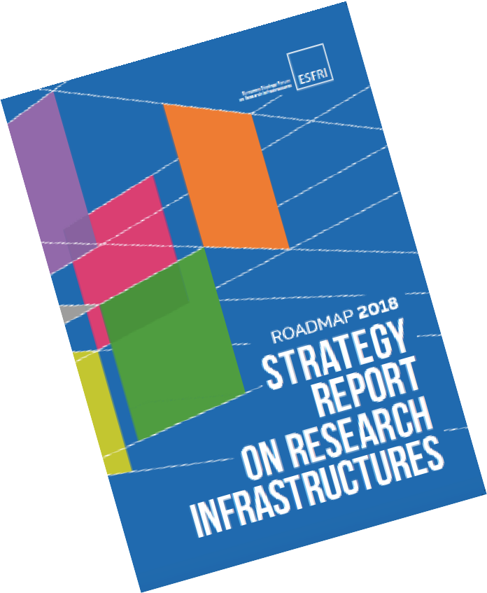
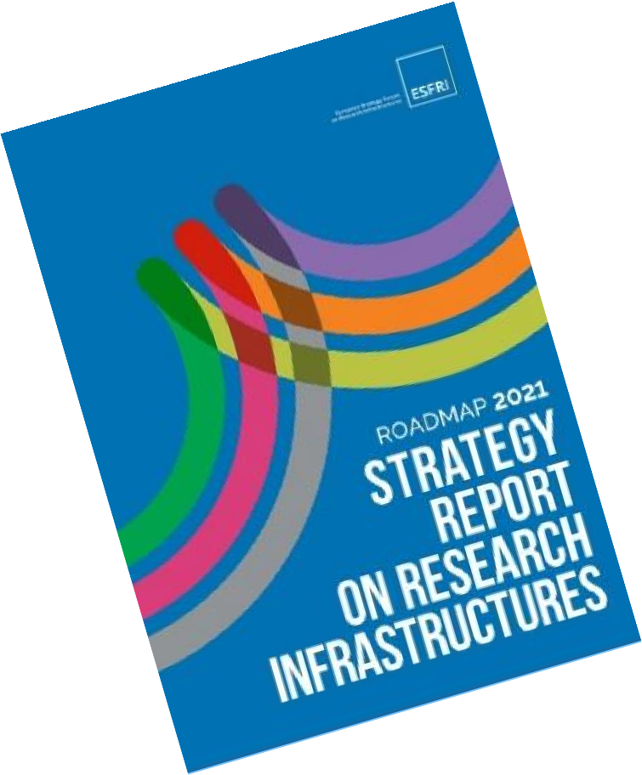
France is supporting the structuring of the European landscape of research infrastructures since more than 60 years:
A founding member state of the first international scientific organisations
like CERN, EMBL or ESO
An active supporter of ESFRI developments since its creation in 2002:
ESFRI roadmap 2021 includes 63 RI (41 Landmarks and 22 Projects)
France is member of 46 research infrastructures out of 63 on ESFRI roadmap 2021.
All these research infrastructures are identified on the French national roadmap.
France is member of 37 Landmarks out of 41 on ESFRI roadmap 2021

Slide 3
French national strategy on research infrastructures
Provides the landscape of national and European/international infrastructures essential to French research and innovation.
The result of a collective process steered by the Ministry of Research, in consultation with the research organizations, institutions, universities as well as other relevant actors responsible for the research infrastructures.
The inclusion of a research infrastructure on the national roadmap represents a seal of quality and recognition of its strategic importance.
5 editions till now: 2008, 2012, 2016, 2018, 2021

Slide 4
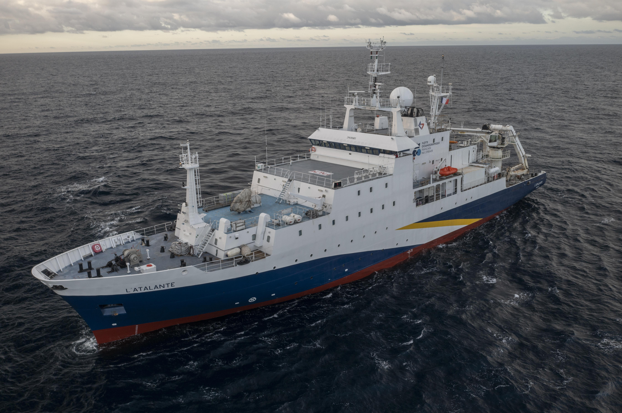
Main objectives of the French national roadmap on research infrastructures
To develop a real strategic analysis of the research infrastructure landscape.
To guarantee a comprehensible, global but non-plethoric vision of the infrastructures that are essential to French research and innovation.
The ESFRI roadmap and Landscape analysis were inspiring and structuring
The French national roadmap puts forward:
The major scientific questions and societal challenges that require the use of research infrastructures;
The positioning of each infrastructure in the roadmap in relation to developments in research, the needs of communities, competing facilities, and any interfaces/complementarities between infrastructures;
Potential gaps to be filled, as well as guidelines for the next years:
prioritization and new synergies to be developed with a view to budgetary sustainability ;
objectives in terms of impact.
Strategic analysis of the infrastructure landscape was also an opportunity to address cross-cutting issues such as open science and data.

Slide 5
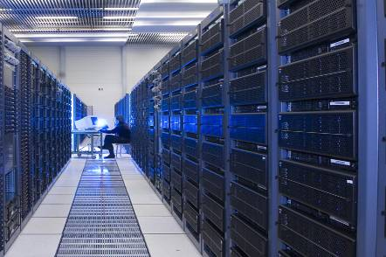
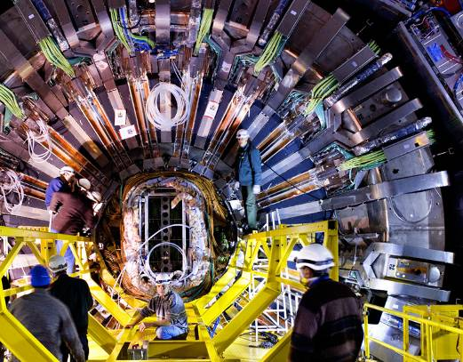
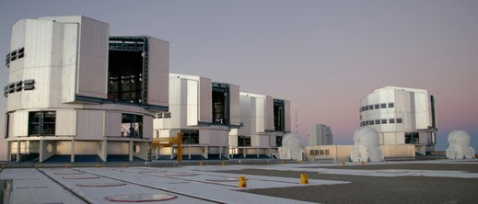
Articulation with ESFRI roadmap
The national roadmap timeline has been articulated with the European timeline of updating the European roadmap for research infrastructures (ESFRI)
Objectives :
- To create a pavement of research infrastructures of the highest international standard that meet the needs of scientific communities
- To think about these infrastructures in the context of the European and international landscape to position our scientific communities in the best possible way

Slide 6
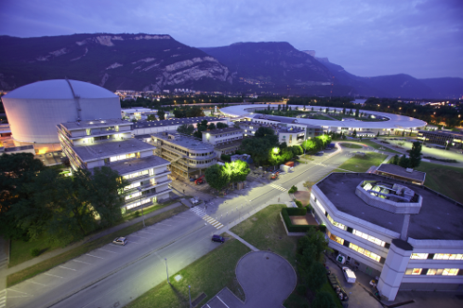
French national roadmap on research infrastructures 2021:
108 research infrastructrues identified.
4 Categories:
5 International Research Organisations based on an intergovernmental convention
23 RI*: Research infrastructures earmarked in the MESR budget, they are part of the national policy, although under the scientific responsibility of research operators.
73 IR: Research infrastructures whose scientific strategy and budget monitoring are the responsibility of the research operators.
7 Projets: Infrastructures that are not yet fully mature but are already of strategic importance in the research landscape.

Slide 7
French national strategy and the European orientations:
Consolidating and improving the European research infrastructures landscape: reflections on the optimization of the RI landscape, structuring role of ERICs but need to make strategic choices
Supporting open science and data-driven research through the European Open Science Cloud (EOSC) : organization of EOSC France community
Enabling and driving green and digital transformation of research infrastructures and through research infrastructures’ services
Issues which have an important impact on the strategy:
Environmental impact and associated costs to ensure the sustainability of research infrastructures
Energy transition and other global challenges
Legal structure of an ERIC is not always an optimal solution: rigid legal rules, in terms of funding sources but also for international partners, etc.
Sustainable funding of RIs: synergy of funding at national and European levels

Slide 8
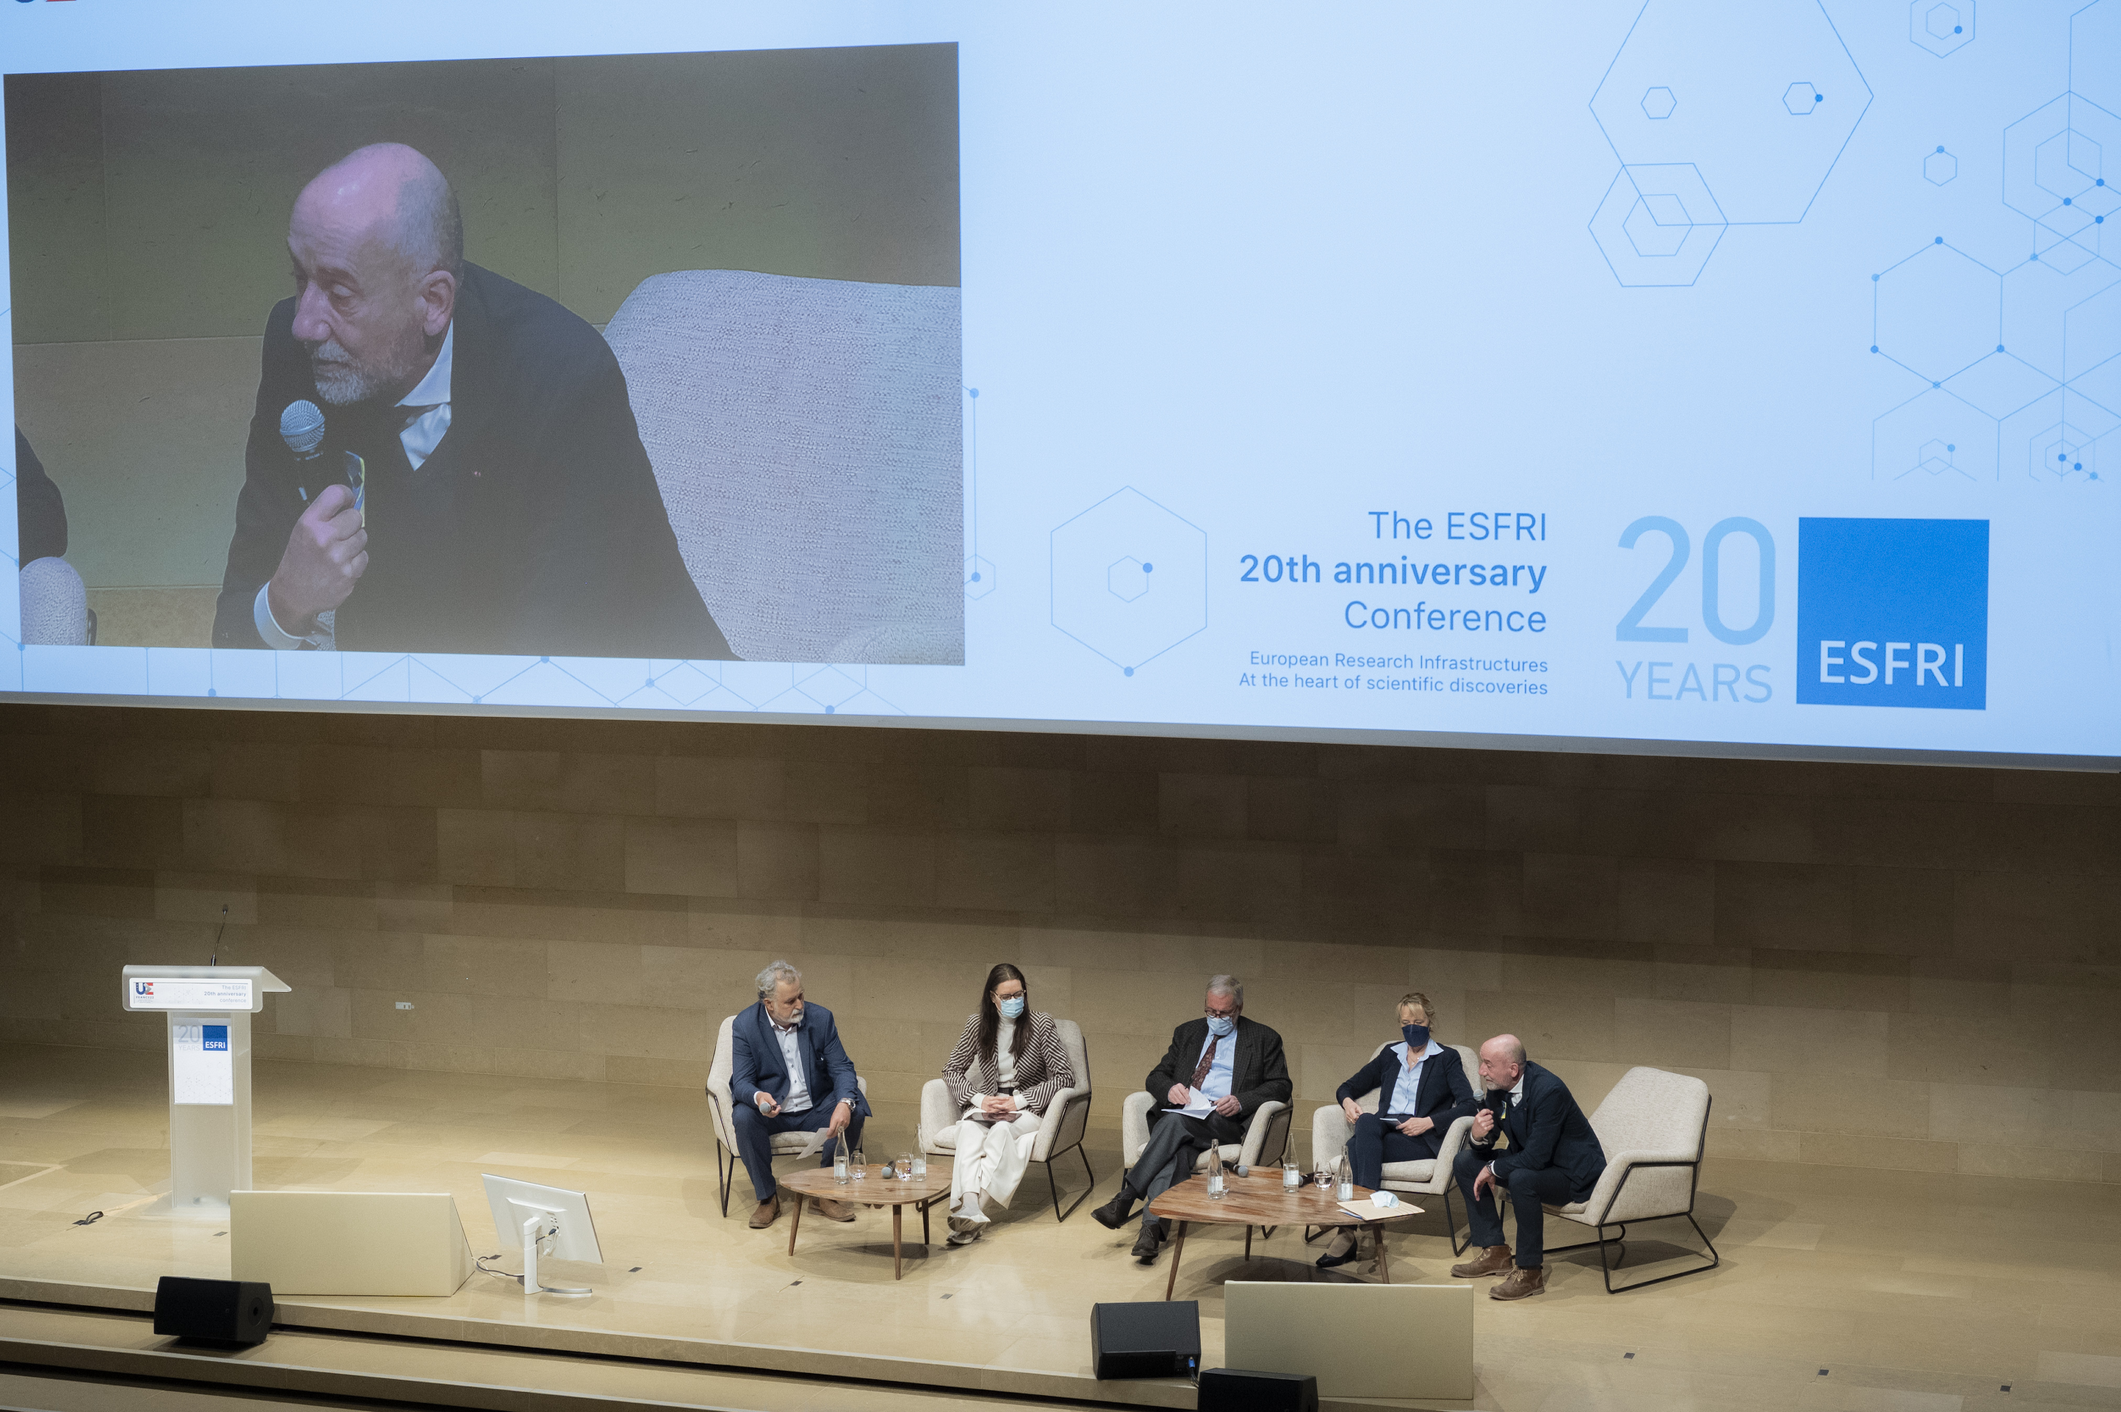
French Academy of Sciences
Conference devoted to the 20th Anniversary of ESFRI:
« Research infrastructures at the heart of scientific discoveries »
Thank you!

